Slide 1





Multi-level modeling, simulation for optimizing vaccination policies
Phd: TRAN Thi Cam Giang
Directors : Yann CHEVALEYRE, Marc CHOISY
VU Dinh Thiem, Jean-Daniel ZUCKER
Doctoral School : EDITE 130,Université Pierre et Marie CURIE
Commencement day : 01/10/2012
Cotutelle scholarship : UPMC/NIHE
Funding: PDI MSI, UPMC/IRD

Slide 2
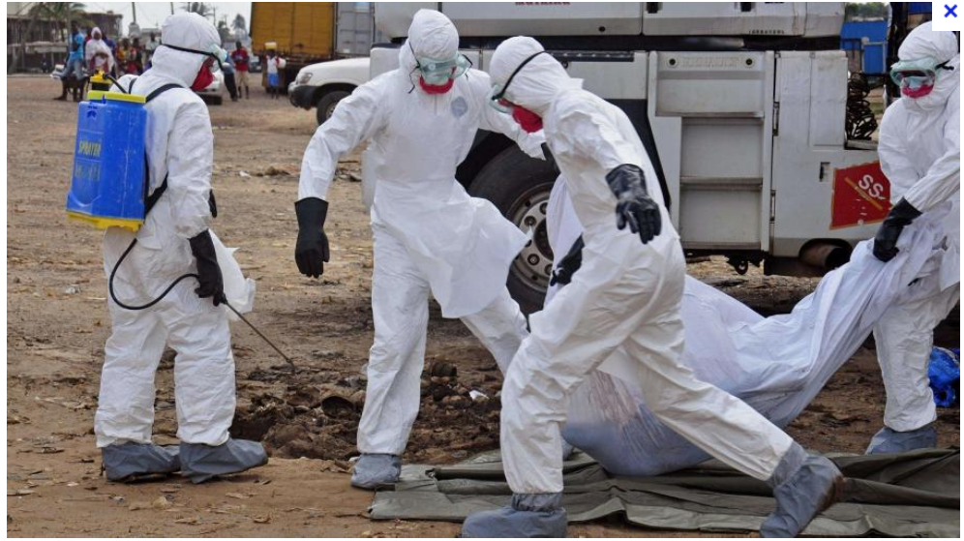
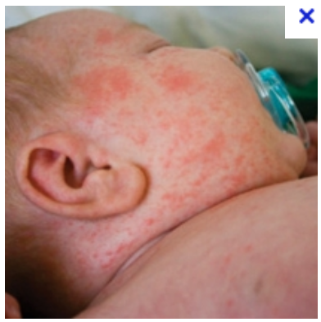
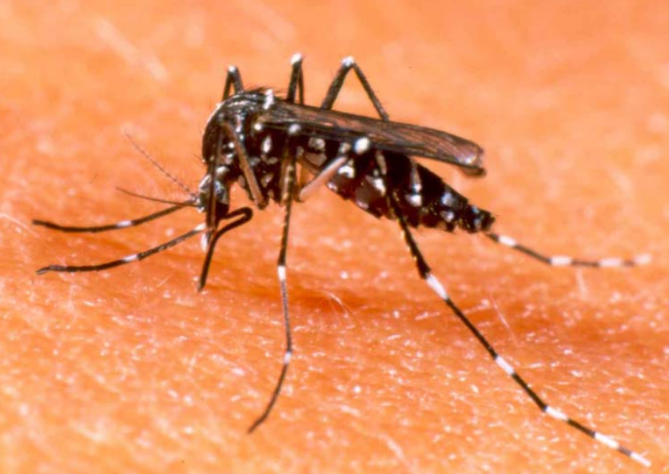
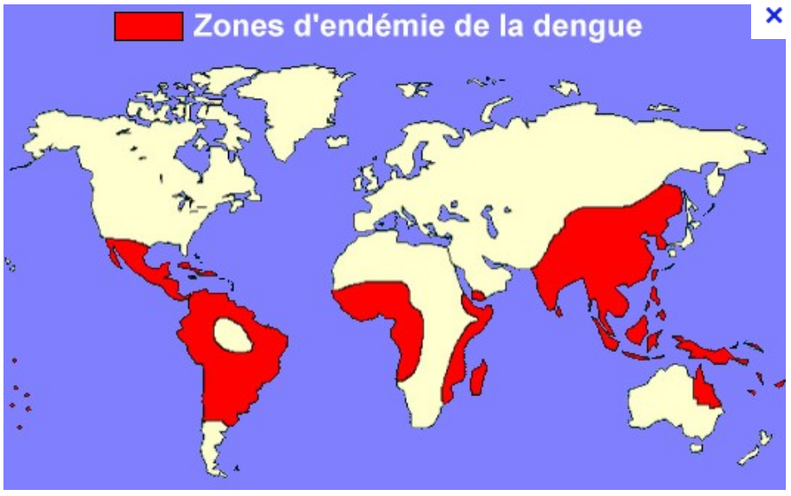

Context et Objective
Many infectious diseases such as measles, dengue in Asia and most countries of southeast Asia. (REF)
Vaccination: Mass policy, the oldest and still most widely used in the world, is to vaccinate a maximal number of children before a certain age. It is already getting a significant decrease about the incidence in many countries,
Problem : is too expensive, ineffective and absolutely impossible to implement in many poor countries, in particular in Africa, Southest Asia..as at the same time financial and logistical problems. (ex. the projet of the WHO about extinction of measles in Vietnam before 2012 is failed).
OPTIMIZING vaccination policies that would be more effective, less expensive than the mass policies.

Slide 3
Context et Objective
Many infectious diseases such as measles, dengue in Asia and most countries of southeast Asia. (REF)
Vaccination: Mass policy, the oldest and still most widely used in the world, is to vaccinate a maximal number of children before a certain age. It is already getting a significant decrease about the incidence in many countries,
Problem : is too expensive, ineffective and absolutely impossible to implement in many poor countries, in particular in Africa, Southest Asia..as at the same time financial and logistical problems. (ex. the projet of the WHO about extinction of measles in Vietnam before 2012 is failed).
OPTIMIZING vaccination policies that would be more effective, less expensive than the mass policies.

Slide 4
Tool?
There exists the R package : very slow !
Using C++ to do stochastic simulation with N = 10M → excellent !
Developping a package integrating R/C++.

Slide 5
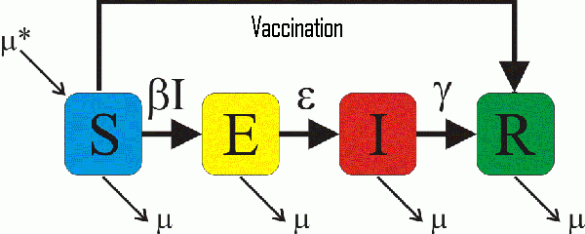
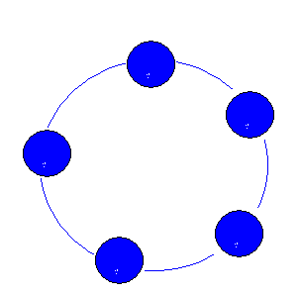
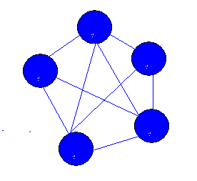
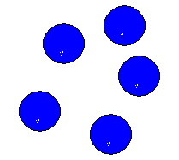

Method
(1) Stochastic Epidemiological model
SEIR Model of population :
Gillespie's Stochastic Algorithm (1977)
Motivation : no extinction in deterministic model
Approach: population-based time-to-event model, 2 steps:
Searching the time of next event
Searching the nature of next event
(2) Spacial Epidemiological Modeling
βI/N

Slide 6

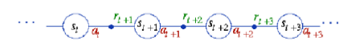
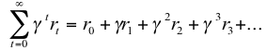

Method
(3) Optimizing vaccinations policies : reinforcement learning
For a structure ò population given, where and when we must vaccinate to vacciner afin de decrease at most the global incidence or crease at most the probability of global eradication.
SARSA : State - Action - Reward – State – Action
A state at time t : (Є N4)
Set of states : N^{4*nbVilles}
Action at time t, vaccination ou non vaccination
Sum of rewards for a policy : ∏ : S → A

Slide 7
Expected Results
The results of this thesis are: an efficient algorithm for optimizing vaccination policies evaluated by spacial and stochastic simulation.
An informatic tool supporting decision of vaccination policies used by health professionals available in the form of an R package (R/C++)

Slide 8
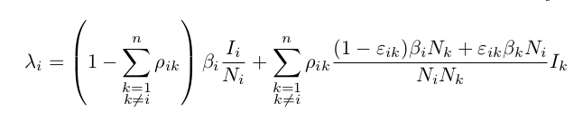
Results 1
Finding the formula of the force of infection in spatial structure.
Modeling and simulation of deterministic and stochastic SEIR model in programming languages​​.

Slide 9
Result 1: package dizzys
The package dizzys simulating temp-spatial epidemic models.
Allow to integrate C ++ in R.
Make deterministic / stochastic simulations for SIR and SEIR epidemic models by using deterministic equations, stochastic algorithms and adaptivetau Gillespie algorithm.
Make simulations for n sub-populations in a meta-population.
Interface displayed by R in 2D, in 3D.

Slide 10
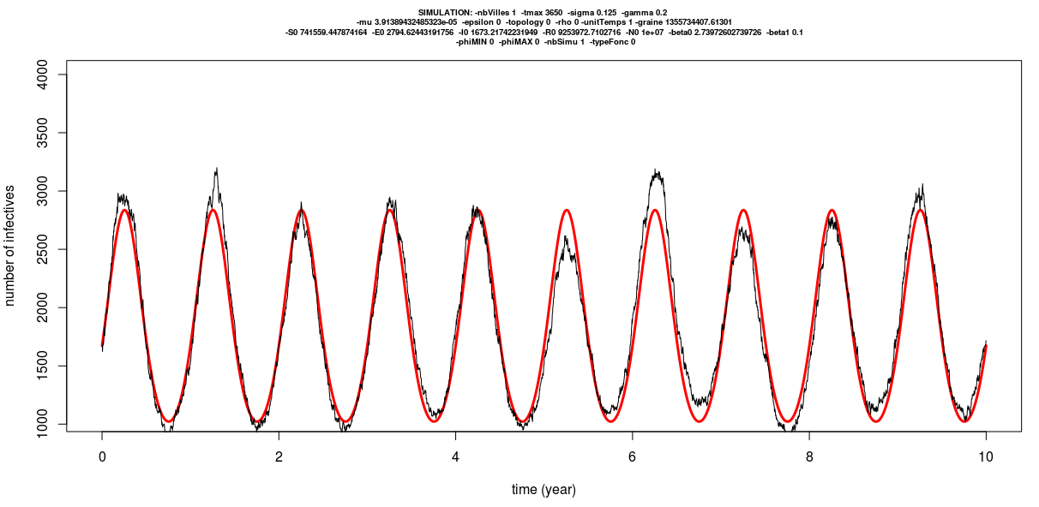
Result 1: Prototype developed under C++ : Example Number of infected for 1 city of 10M individuals

Slide 11
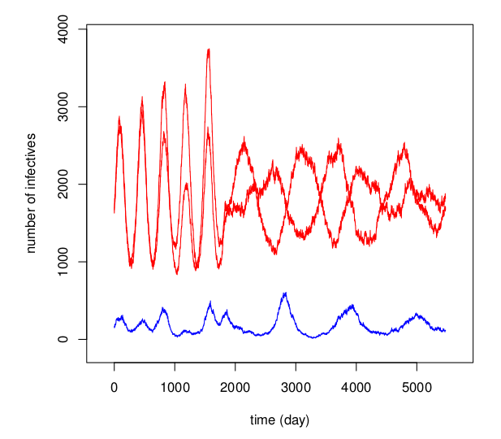
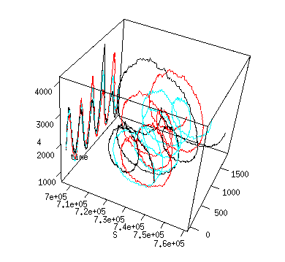
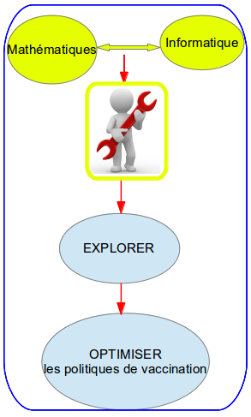
Result 1: : package dizzys simulation in 2D and 3D
Metapopulation of three cities,
N={10⁶,10⁶,10⁵}, φ_{Max}={0,π}
Metapopulation of three cities,
N={10⁶,10⁶,10⁶}, φ_{Max}={0}
\mu=1/(70*365) par jour, \beta_0=1250/365 jour, \beta_1=0.1jour, 1/\sigma=8 jours, 1/\gamma=5 jours, \varphi=0, temps de simulation = 10 ans.

Slide 12
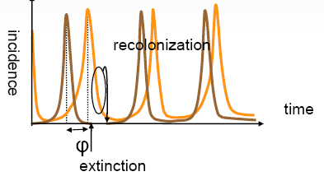
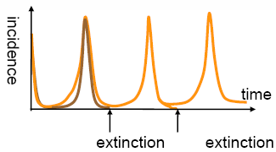
Question 1: persistence in the simulated model
Asynchronie spatiale
Spatial synchrony
Asynchronie spatiale
Spatial Asynchrony
Extinction at larger scale
no extinction at larger scale

Slide 13
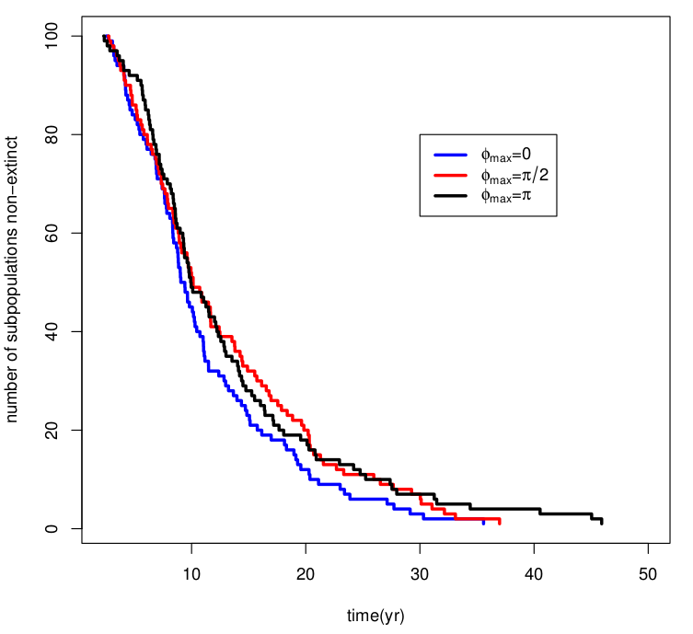
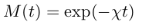
Solution of Q1 : EXPLOITING dizzys
Survival curve Kaplan-Meier
EXPLOITING the tool dizzys for the persistence in the model simulated.
FINDING the characteristics of the global persistence. This is the survival curve which is shaped
where M (t) is the number of meta-populations that are not extinct at time t.
M(t)=exp(-χt)
NbVilles=02, N=3*10⁵ tmax=50 ans, ρ=0.001
Notes:
---> la persistance globale dans une métapopulation est comme une fonction exponentielle.

Slide 14
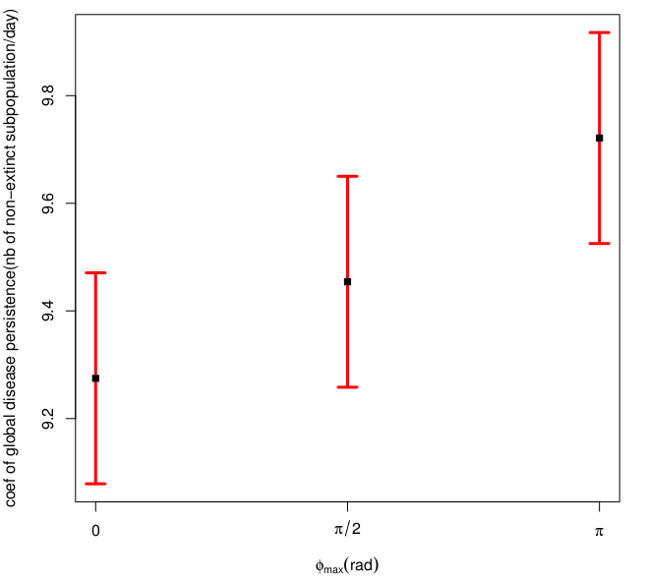
Result 2 : Persistence 1
ESTIMATING the global persistence of an infectious disease and φ_{Max}
Estimated rate of global disease persistence in the metapopulation of 08 subpopulations
after 100 different simulations N=3e5, coupling rate $\rho=0.1.

Slide 15
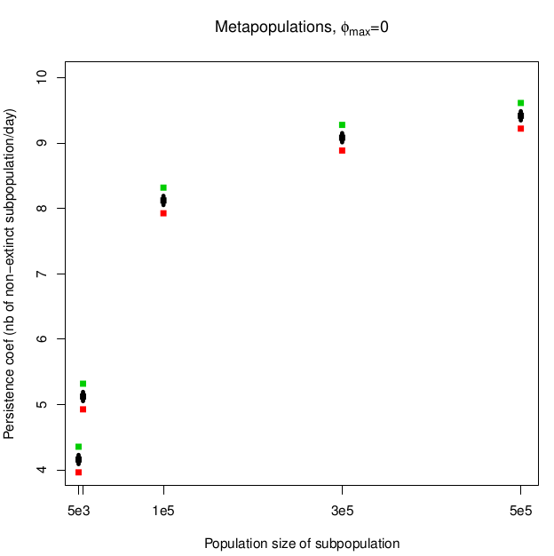
Result 2 : Persistence 2
Influence of the population size on the global persistence of disease
Estimated persistence rate in the metapopulation of 06 subpopulations
after 100 different simulations.
The population size of subpopulation is in the set {5000, 10000, 1e5, 3e5, 5e5}

Slide 16
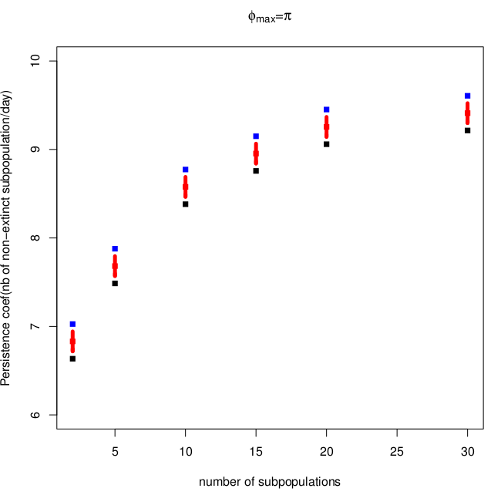
Result 2 : Persistence 3
Influence of the number of subpopulation in one metapopulation
On the global persistence of disease.
Estimated persistence rate in the metapopulation of multi-subpopulations
after 100 different simulations.
The number of subpopulations alters in the set {2, 5, 10, 15, 20, 25, 30}

Slide 17
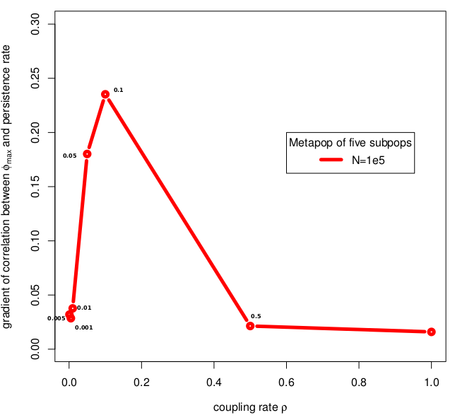
Result 2 : Persistence 4
Influence of the coupling rate among subpopulations in a metapopulation
on the slope of the coef. of global persistence to φ_{Max}
Coupling rate \rho = {0.001, 0.005, 0.01, 0.05,0.1, 0.5, 1},
phiMAX={0,pi/2,pi} and the population size N=1e5.
NbVilles = 05

Slide 18
Conclusion
In summary, the degree of asynchrony increases the global persistence time of an infectious disease.
NOW :
GIVING an efficient algorithm for optimizing vaccination policies evaluated by spacial and stochastic simulation.
Evaluating this algorithm.

Slide 19
Manuscript in preparation: T.C.G. Tran, J.D. Zucker, M.Choisy, Quantifying the effect of synchrony on the persistence of infectious diseases in a metapopulation.

Slide 20
Reference
REFERENCES
1- Earn, D. J.; Rohani, P. & Grenfell, B. T. Persistence, chaos and synchrony in ecology and epidemiology. Proceedings of the Royal Society of London B, 1998, 265, 7-10
2- Grenfell, B. T.; Bjørnstad, O. N. & Kappey, J. Travelling waves and spatial hierarchies in measles epidemics. Nature, 2001, 414, 716-723
3- Nokes, D. J. & Swinton, J. Vaccination in pulses: a strategy for global eradication of measles and polio?
S. Altizer, A. Dobson, P. Hosseini, P. Hudson, M. Pascual, and P. Rohani. Seasonality and
the dynamics of infectious diseases. Ecol Lett, 9(4):467484, Apr 2006.
4- R. M. Anderson and R. M. May. Infectious Diseases of Humans: Dynamics and Control. Oxford University Press, 1992.
5- B. Bolker and B. Grenfell. Space, persistence and dynamics of measles epidemics. The Royal Society, 348:309320, 1995.
6- D. T. Gillespie. Exact stochastic simulation of coupled chemical reactions. The journal of
physical chemistry, 81(25):23402361, 1977.
7- B.T. Grenfell, B. M. Bolker, and A. Klegzkowski. Seasonality and extinction in chaotic metapopulation. The royal society, 259:97103, 1995.
8- M. J. Keeling and B. T. Grenfell. Understanding the persistence of measles: reconciling theory, simulation and observation. Proc Biol Sci, 269(1489):335343, Feb 2002.
10- M. J. Keeling and P. Rohani. Modeling Infectious Diseases in humans and animals. Princeton University Press, 2008.
11- A. L. Lloyd. Realistic distributions of infectious periods in epidemic models: changing patterns of persistence and dynamics. Theor Popul Biol, 60(1):5971, Aug 2001.
12- E. Renshaw. Modelling biological populations in space and time, volume 11. Cambridge Uni-
versity Press, 1993.
13- T. M. Therneau. A Package for Survival Analysis in S, 2014. R package version 2.37-7.
14- WHO. Reported measles cases with onset date from oct 2013 to mar 2014, 2014.
15-http://microbiology.mtsinai.on.ca/faq/transmission.shtml
16- http://en.wikipedia.org/wiki/Epidemic_model
17-Nokes, D. J. & Swinton, J. Vaccination in pulses: a strategy for global eradication of measles and polio? Trends Microbiol, 1997, 5, 14-19
….......

